Slide 1

Raspberry Pi-Powered Unified AIoT System for Storage, Security & Automation
Subject Name: Intelligent Systems and Security
Subject Code: CTMTAIDS SII P4
Guided By: Ms. Dristi Garadhari
School of Cyber Security & Digital Forensics
M.Tech Artificial Intelligence & Data Science
(Specialization in Cyber Security)
Year / Sem: 1st / 2nd
Session Year: 2024 -26
Presented by: Pratham Badge
Enrolment No.: 2401003007003

Slide 2
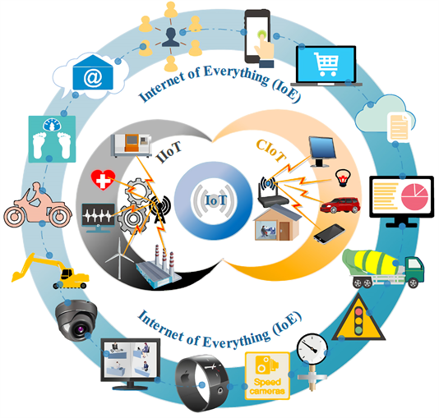
Introduction
What is IoT?
IoT (Internet of Things) refers to interconnected physical devices that collect and exchange data over the internet..
Why AI + IoT in Cybersecurity?
The integration of AI with IoT enhances system intelligence through real-time monitoring, autonomous threat detection, adaptive security measures and automation.
Motivation:
As a tech enthusiast I am aiming to create an efficient, low-powered multifunctional pocket system, physical prototyping on Raspberry Pi is costly and time consuming, making virtual simulation an ideal, cost-effective, and agile solution for early stage testing.

Slide 3
Problem Statement
Designing a compact IoT system that integrates NAS/media server, AI-driven IDS/IPS with firewall, virtualization, an AI chatbot, and home automation—entirely on a Raspberry Pi—presents several challenges:
Limited hardware resources restrict multi-function integration.
Real-time AI tasks need lightweight, low-latency and optimized models.
Safe and Secure development demands sandboxed simulation and testing before real-world implementation.
Must be user-friendly and easily deployable.

Slide 4




Project Objective
Simulate Raspberry Pi virtually
Build and test AI/ML and cybersecurity tools efficiently.
Ensure feasibility before hardware deployment.
Easy to use and deploy

Slide 5








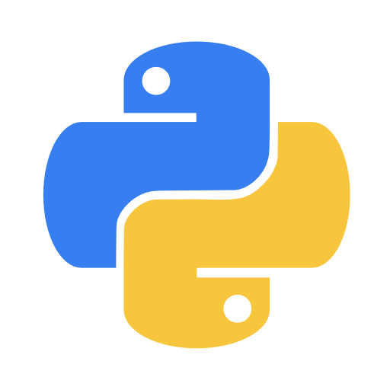




Tools & Technologies
Software
Hardware (Future Stage)
QEMU (ARM Emulator)
Raspberry Pi OS (Legacy or Lite for performance)
OpenMediaVault (for NAS & media server)
OpenVPN (open-source VPN protocol for secure and encrypted connections)
pfSense or Proxmox (for firewall/virtualization)
Python, OpenCV, Scikit-learn, TensorFlow, MQTT
Raspberry Pi 5
Modules (WiFi, 5G, SSD)
SD Card, Power Adapter

Slide 6
Simulation Setup
Install QEMU v10.0+
Download Raspberry Pi OS (Full Image)
Fetch compatible kernel and dtb file
Run using PowerShell/Terminal:
& "qemu-system-arm" -kernel [kernel-path] -M versatilepb -cpu arm1176 -m 256 \ -drive file=[img-path],format=raw -dtb [dtb-path] \ -append "root=/dev/sda2 panic=1 console=ttyAMA0" -nographic -net user -net nic

Slide 7
Benefits of Simulation
No need to purchase hardware initially.
Safe testing environment for exploits and AI models.
Debug, patch, and iterate quickly.
Easily deployable and portable.

Slide 8
Simulation POV

Slide 9
Use Cases & Applications
AI-Enhanced Smart Home Automation (Face Recognition, Intrusion Detection)
Lightweight AI-Powered IDS/IPS with Real-Time IoT Traffic Analysis
Unified Device Authentication System
ML-Driven Anomaly Detection for Home Sensors
Secure Mini Media & Storage Server

Slide 10








More Use Cases & Applications
Identification
Analysis
Authentication
Smart Home Security (Face Recognition, Intrusion Detection)
5G-based IoT Traffic Analysis
AI-Powered Device Authentication

Slide 11
Project Outcome
1
Successfully emulated Raspberry Pi OS.
2
Demonstrated potential for AI + IoT testing.
3
Explored GPIO simulation capabilities (future step).

Slide 12
Conclusion
Based on the Research
Simulation enables safe, cost-effective prototyping and testing.
Accelerates development of AI-integrated IoT systems.
Establishes a foundation for secure, smart, and user-friendly edge solutions

Slide 13


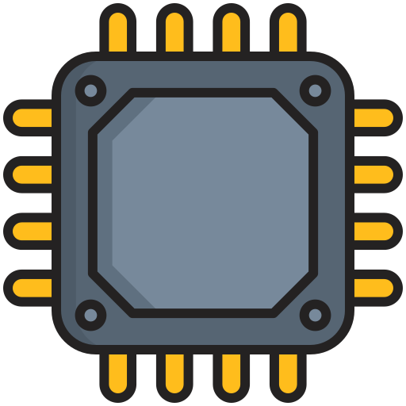

Future Scope
14K
82K
Virtual GPIO Simulation
Cloud AI Integration
Real Hardware Deployment
Security
Testing
Simulate GPIO operations using tools like PiGPIO, GPIOZero.
Use cloud-hosted AI (e.g., Hugging Face) for advanced inference.
Transition to physical Raspberry Pi 5 after virtual validation.
Expand into Red Team vulnerability assessments for IoT environments.

Slide 14
Summary
Project Title: Raspberry Pi-Powered Unified AIoT System
Core Idea: All-in-one compact, low-power solution for storage, security, AI, and automation.
Key Features: NAS/media server, AI-powered IDS/IPS with firewall, virtualization, chatbot, smart home automation.
Approach: Developed and tested via Raspberry Pi OS emulation using QEMU before real deployment.
Technologies Used: QEMU, OpenMediaVault, pfSense/Proxmox, Python, AI/ML libraries.
Outcome: Validated the concept, architecture, and feasibility in a simulated environment.

Slide 15


Thank you
Q & A Session Open to questions, collaborations, and suggestions for advancing secure & smart AIoT solutions.
Connect with Me: sinister-virus@outlook.com
LinkedIn: Pratham Badge
GitHub: sinister-virus

